Slide 1
03
Multi-Modal Breast Cancer Survival Analysis
Independent project integrating clinical metadata, microarray gene expression, and somatic mutation data to predict patient survival outcomes

Slide 2
Motivation & Approach
Clinical Motivation
Traditional survival models (Cox Proportional Hazard) and newer ML models (DeepSurv) primarily utilize clinical features
Individual Motivation
Improve knowledge on:
Multi-modal Integration
Building predictive models (PyTorch)
New Disease Context (Breast Cancer)
What if we took an integrated approach, combining:
Clinical Metadata
Gene Expression
Mutation information
For improved survival prediction?
Data: METABRIC
Molecular Taxonomy of Breast Cancer International Consortium
1800 Breast Cancer Patients
Clinical Metadata
Microarray Data (Gene Expression, 18,000 genes)
SNP Genotyping (Mutation)
Approach
Cox Proportional Hazards Model: Clinical Only (Baseline)
Cox PH Model: Clinical & Gene Expression
Neural Network Based Model fusing all 3 modalities

Slide 3
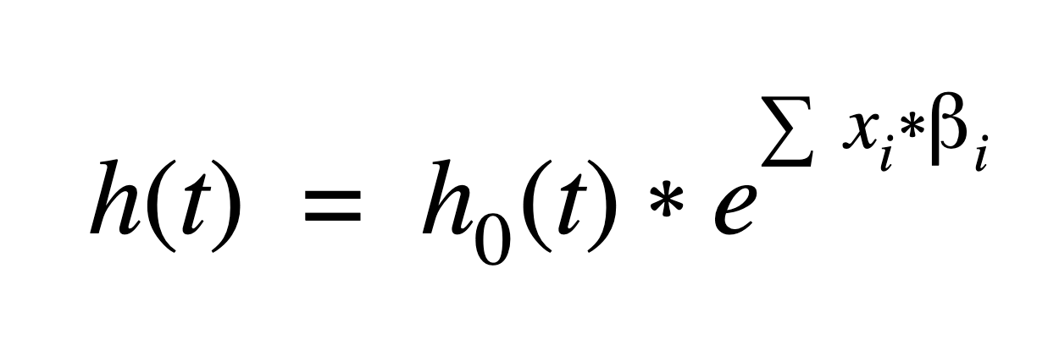
Cox Proportional Hazards Model
The hazard function h(t) gives the instantaneous rate of an event (cancer death) occuring at time t, given survival up until that point.
Cox PH models how patient features (x_{i}) shift that rate
Model assumes each feature multiplies the baseline hazard by a constant factor at all time points
Patients who don’t experience the event before the study ends are censored: meaning their data still contributes to the likelihood, informing model on survival up until that point
h(t): Hazard function. Instantaneous risk of death at time t
h₀(t): Baseline hazard. Underlying hazard when all variables are zero
x_{i}: Covariate values. Measured clinical variables for a given patient
B_{i}: Regression coefficients. Weights learned from the data for each covariate

Slide 4
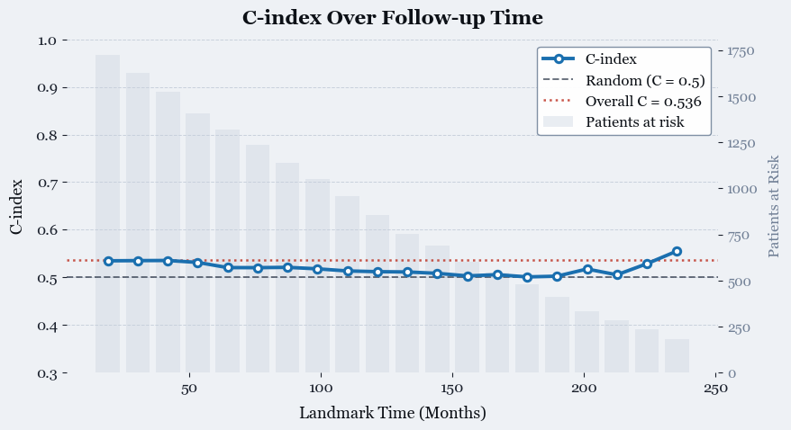
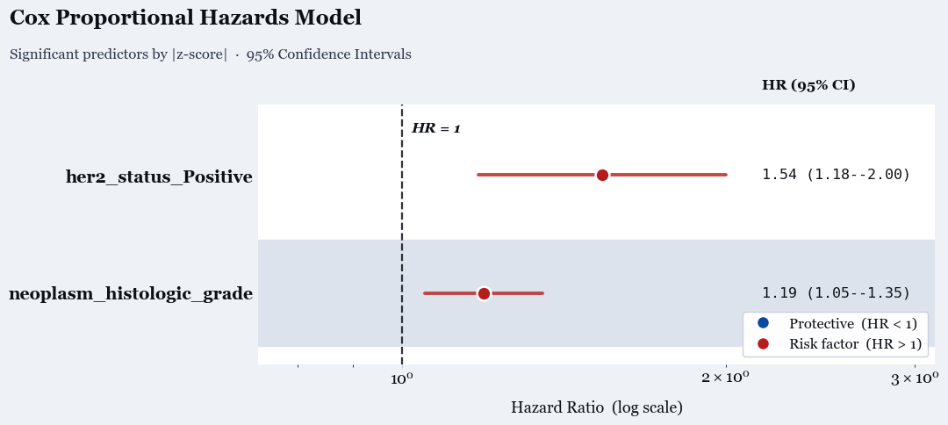
Cox Proportional Hazards - Clinical Baseline
Modeling Setup
Input: 11 clinical features (ex: HER2, PR status, tumor size, age)
Data stratified by chemotherapy and radiotherapy (these reflect disease severity, not causal risk)
Model Performance
Concordance Index: model’s ability to correctly rank patients by risk
Ranges from 0.5 (random) to 1.0 (perfect)
Our clinical-only model: C-index = 0.536 (barely better than random)
Biological Interpretation
Hazard Ratio: Multiplier on risk
HER2+ positive patients have HR = 1.54, meaning at any point in time they are 1.54x more likely to die than HER2- patients
HER2 overexpression is established driver of tumor growth
Histological grade directly reflects how fast-dividing tumor is

Slide 5
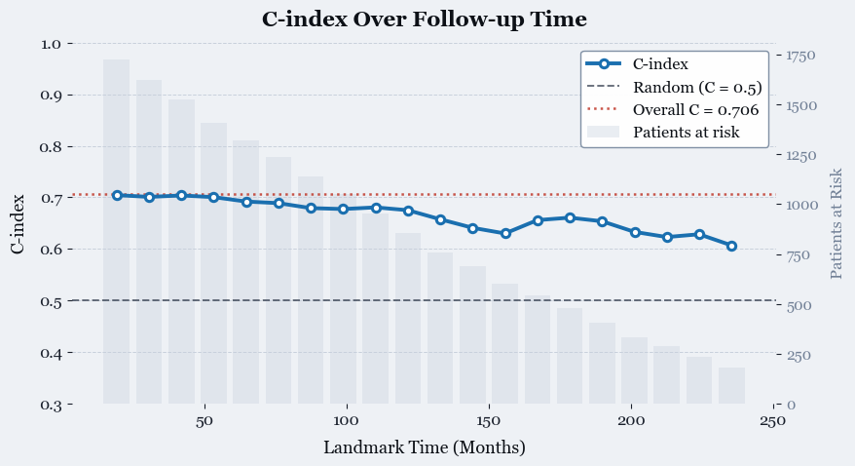
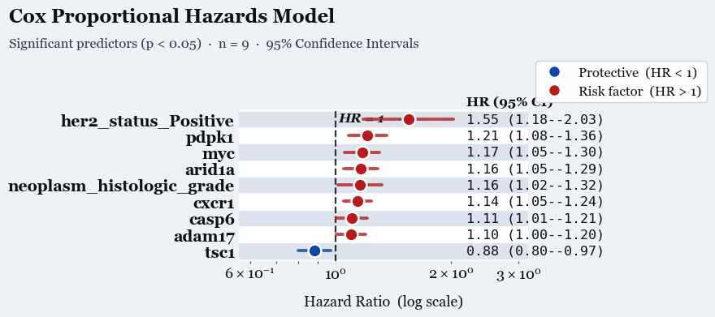
Performance and Biological Relevance Improve with Gene Expression Addition
Cox Modeling with Clinical Metadata + Gene Expression
Create Cox Model with ALL 18,000 genes and no clinical data
Regularize/reduce feature space with Elastic Net
Select genes with HR>1.05 or HR<0.95 (top predictive genes)
Cox Model with clinical data (11) and selected genes (13)
Model Performance Improves Considerably
C-index = 0.70 (previously 0.53)
Biological Interpretation
HER2 status and Histological Grade still both top predictors
PDPK1: Part of PI3K/AKT signaling pathway, driver of cell proliferation
MYC: well-known oncogene, also drives cell proliferation
TSC1: Only significant protective factor. TSC1 is a tumor suppressor inhibiting the mTOR pathway, slowing tumor growth

Slide 6
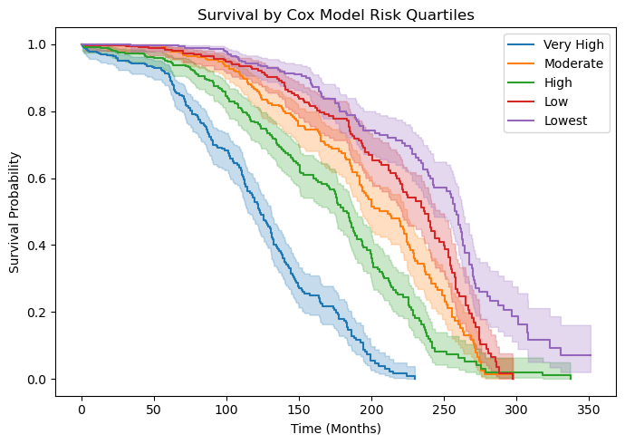
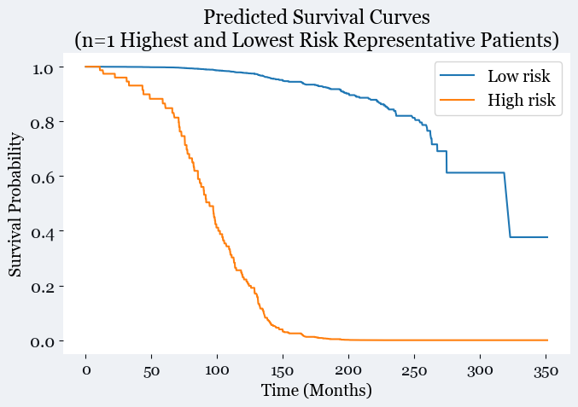
Kaplan-Meier Curves for Patients split by Risk Group
Patient Survival Split into 5 Groups by Risk Score
Patients split into 5 equal groups, from lowest to highest risk score calculated by model
Model accurately separates risk groups for 250+ months
Lowest / Highest Risk Patients Survival Probability
Survival function predicted from Cox Hazard Model
Model predicts highest risk patient has < 10% chance of survival after 150 months
Model predicts lowest risk patient has 60% chance of survival after 300 months

Slide 7
PyTorch Deep Neural Model Original Strategy
Original Training Strategy
Train clinical-only PyTorch model, optimizing width and depth of layers, and freeze weights
Add and train Z-scored microarray expression encoder, optimize, and freeze weights
Add and train binary mutation encoder and optimize
Fine-tune all layers for fine model
Evaluation Strategies
Evaluate C-index
Evaluate time-dependent AUC
Evaluate Integrated Brier Score
Plot Kaplan-Meier Curves of risk groups
Compare to clinical + gene expression CoxPH model

Slide 8
Original Multi-Modal Neural Network Architecture
Clinical Metadata
(~10 features)
Clinical Encoder
8-dim
Gene Expression
(~18k genes)
Expression Encoder
64-dim
Concat Fusion
(8+64+32)->64
Risk Output
(64->1)
Mutation Matrix
(Binary, ~200 SNPs)
Mutation Encoder
32-dim
Originally, the plan was to have 3 separate encoders for each modality, followed by a fusion encoder combining the modalities, and a risk output

Slide 9
Final Multi-Modal Neural Network Structure
Clinical + Mutation Metadata
29 Clinical Feats
26 Mutation Feats
(55 Total Features)
Clinical + Mutation Encoder
Layer dims: 55->32->16
ReLu & 30% Dropout between layers
Concat Fusion
(16+32)->32
ReLu & 30% Dropout between layers
Risk Output
(32->1)
Gene Expression
(489 genes)
Survival-Aware Autoencoder
Final Model has two separate neural networks, with concat fusion combining them at the end:
Survival-Aware Expression Autoencoder
Encoder compresses 489-gene microarray data into 32 latent dimensions
Decoder reconstructs original gene data, with loss functions for both reconstruction accuracy AND survival-aware cox partial likelihood loss
Clinical + Mutation Metadata Encoder
Separate mutation encoder resulted in all metrics worse (C-index, IBS, AUC) in testing
29 Clinical features, 25 most frequent mutations, and per-patient Tumor Mutational Burden (55 features) as input
Concat Encoder takes 16 clinical feature vector and 32 dim expression vector and outputs 1 risk score
Expression Encoder
489->256->128-> 32 Latent Dimensions
ReLu & 30% Dropout between layers
ReLu: Rectified Linear Unit
For input x, f(x) = max(x,0)
Adds non-linearity to network
30% Dropout:
Regularization, randomly deactivating 30% of nodes within a layer.
Prevents overfitting/ reliance on specific nodes
Expression Decoder
32 Latent Dims -> 128 -> 256 -> 489
ReLu between layers

Slide 10
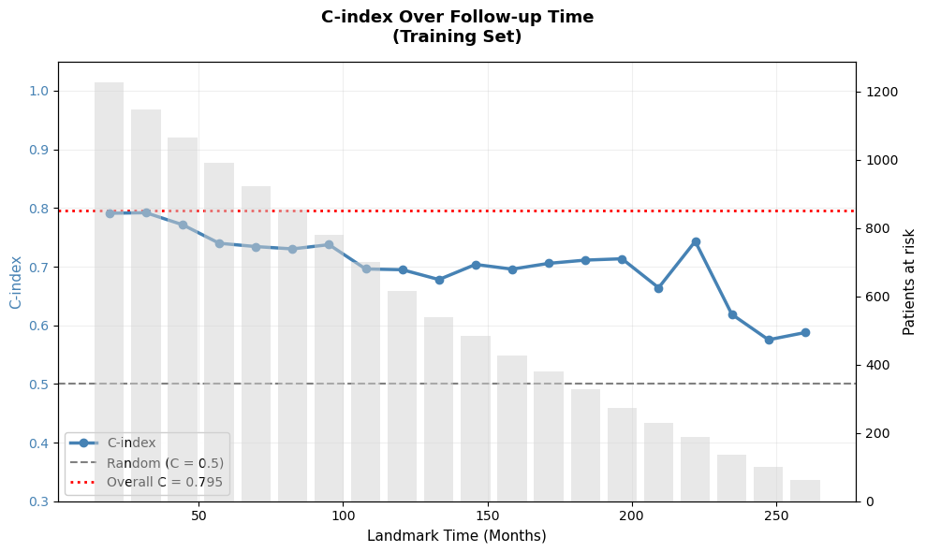
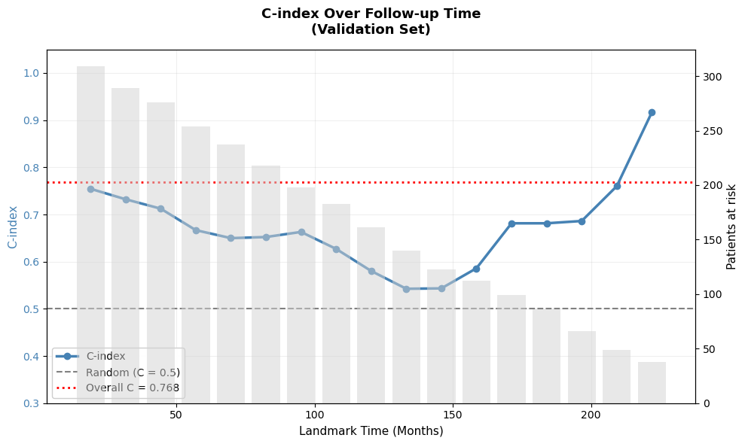
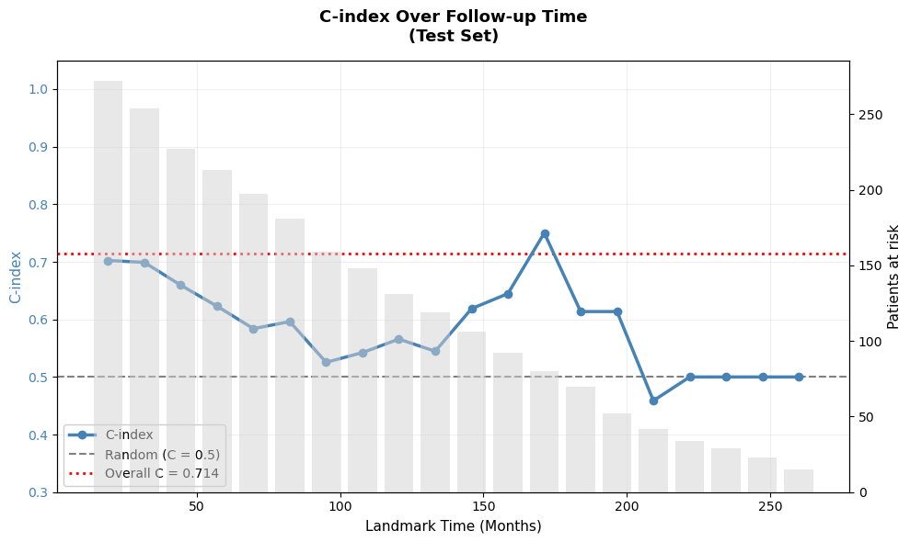
Model Performance Results: Concordance Index shows solid model in first 100 months, but overfitting at later time points
1. On training set, C-index remains around 0.70 from 50 to 200 months, before decreasing considerably.
This is expected behavior, C-index decreases over time due to reduced patients, censoring, and “risk clustering” (many patients with similar risk profile
2. The validation set was used for evaluating which weights performed best during model training.
Due to this, we see significant overfitting. It would be best to retrain the model using cross-validation instead.
C-Index Results Takeaway:
For 0-100 months, the model provides robust predictions of risk based on C-index
From 100-150 months, training, validation, and test performance begin to diverge, and predictions should be taken with caution
Beyond 150 months, the model should not be used due to overfitting.
NEXT: Retrain model without overfitting
3. On test set, C-index remains at or above 0.60 until ~100 months, at which point it falls close to 0.
At 140 months onwards, the test C-index spikes above 0.70, then down to below 0.50 (worse than guessing). This is likely due to overfitting

Slide 11
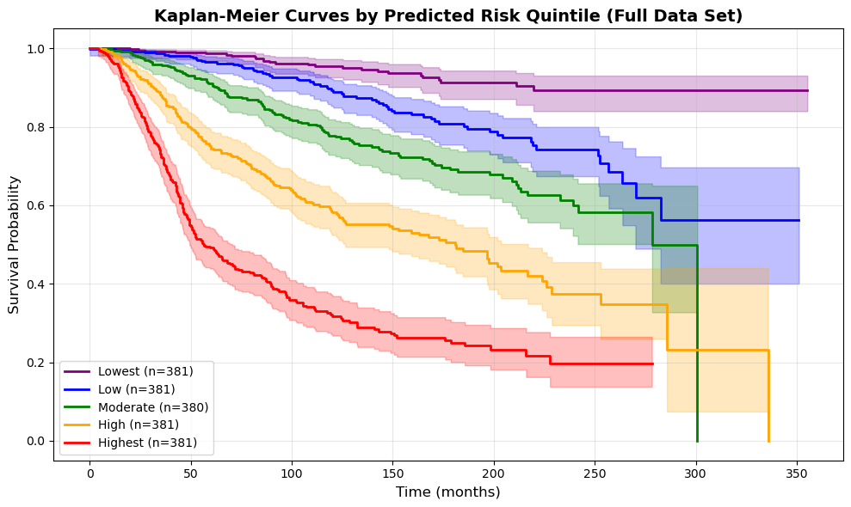
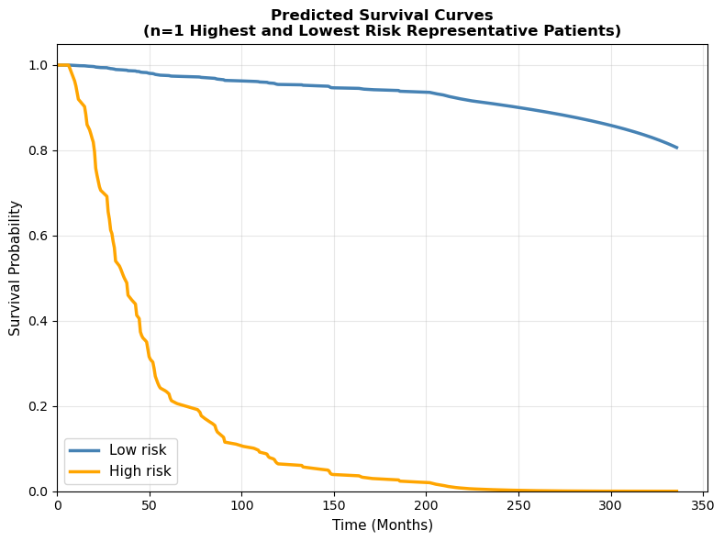
Kaplan-Meier Curves for Patients split by Risk Group
Patient Survival Split into 5 Groups by Risk (Full Data)
Patients split into 5 equal groups, from lowest to highest risk score calculated by model
Model separates risk groups for 250+ months
Lowest / Highest Risk Patients Survival Probability
Breslow estimator used to determine cumulative hazard over time
Model predicts highest risk patient to have 20% chance of survival after just 50 months, while lowest risk patient has 80% chance of survival after 300 months

Slide 12
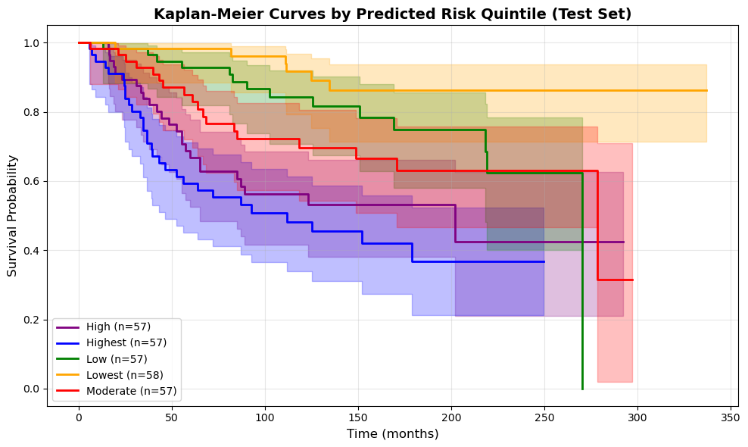
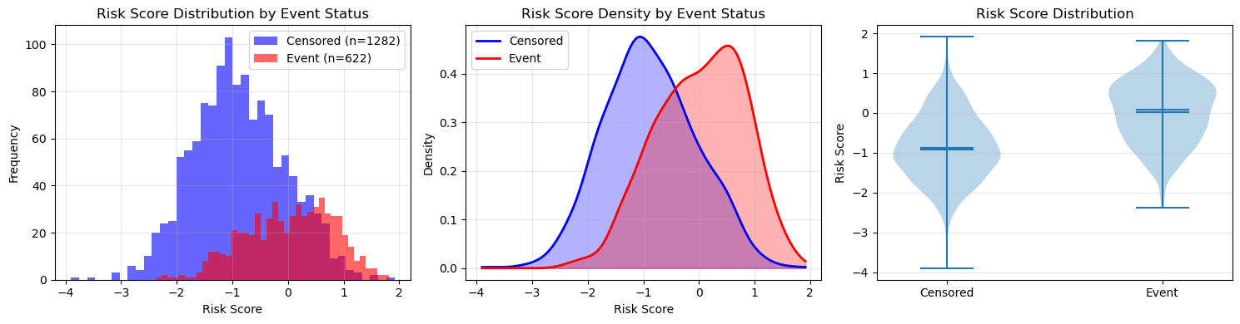
Kaplan-Meier Curves by Risk in Test Set
By Mann-Whitney U test, risk score distribution is significant different between Censored and Event
In test set, significant separation between risk groups before 200 months.
Event rate in each risk group increases monotonically:
Lowest risk: 6.6%
Low risk: 17.6%
Moderate risk: 28.2%
High risk: 43.8%
Highest risk: 67.2%
Good stratification of risk

Slide 13
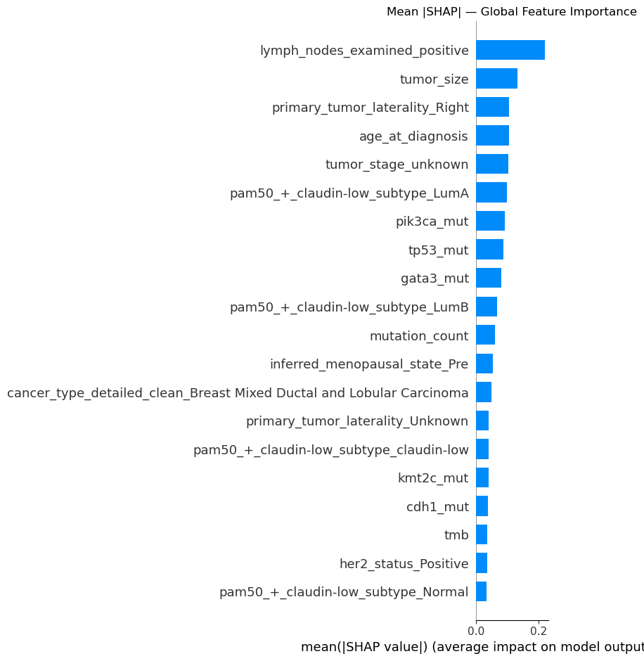
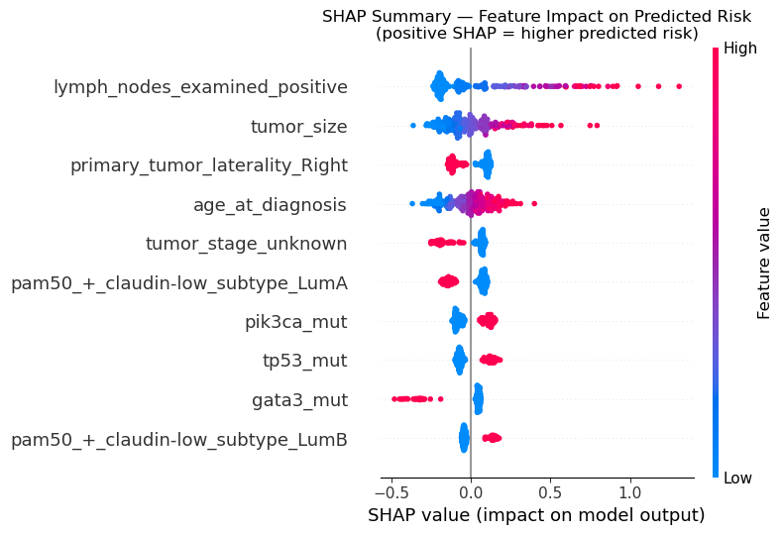
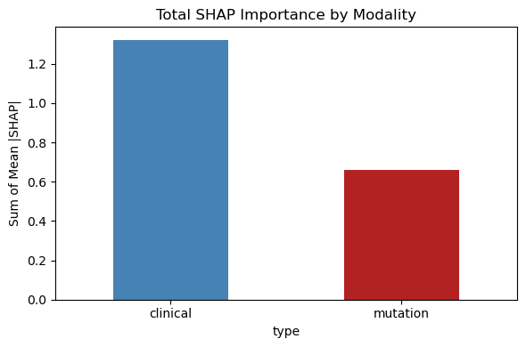
SHAP Analysis of Clinical/Mutation Features
Biological Interpretation:
Lymph nodes positive for breast cancer and tumor size both are positively correlated with breast cancer risk, this is validated by literature
Left-sided tumor laterality results in higher risk, however literature says this is clinically uninformative. This is a potential bias, will consider removing
Tumor stage unknown results in lower risk compared to known tumor stage. This is another potential bias, will consider removing.
Higher age results in higher risk score, aligning with literature.
PAM50+ LumA subtype is protective, while PAM50+ LumB is higher risk, aligning with clinical biology
TP53 and PIK3CA mutations result in higher risk score. These are both cancer driver mutations, correlated with literature.
GATA3 mutation results in lower risk in our model. GATA3 mutations are tumor drivers, but they paradoxically result in better patient survival. Our model has picked up on this
Left Figure: Mean SHAP, Global Feature Importance:
Top 20 Clinical and Mutation Features by mean SHAP, quantifying the contribution of each feature to risk prediction
Middle Figure: Feature impact on Predicted Risk
Each colored dot is an individual value for a feature, and x axis position indicates impact on model output
Right Figure: Sum of Mean SHAP for clinical and mutation features
All together, clinical features were more impactful on risk score compared to mutation information

Slide 14
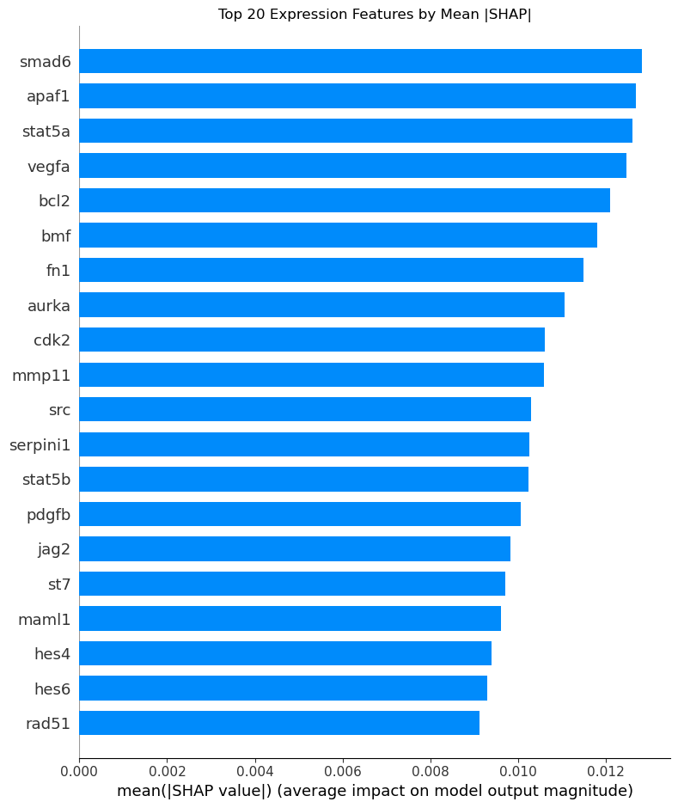
SHAP Analysis of Expression Features
SMAD6 (inhibitor of TGF-β signaling) - High expression may reflect suppressed anti-proliferative signaling, allowing tumors to evade differentiation and growth arrest mechanisms
APAF1 (apoptosis protease-activating factor) - Reduced or aberrant expression impairs intrinsic apoptotic pathways, enabling cancer cells to survive despite DNA damage and cellular stress
STAT5a (signal transducer and activator of transcription 5a) - Elevated expression drives proliferation and anti-apoptotic signaling in breast cancer cells; associated with aggressive luminal and HER2+ subtypes
VEGFA (vascular endothelial growth factor A) - High expression promotes tumor angiogenesis and metastatic potential, key mechanisms of aggressive disease progression
BCL2 (B-cell lymphoma 2) - Enhanced anti-apoptotic function allows survival of malignant clones and chemotherapy resistance
BMF & FN1 - BMF (pro-apoptotic) suppression enables survival advantage; FN1 (fibronectin) promotes epithelial-mesenchymal transition (EMT) and invasive capacity
AURKA (aurora kinase A) - Overexpression drives chromosome instability and mitotic errors, associated with high-grade, aggressive tumors
CDK2 - Elevated cyclin-dependent kinase activity accelerates cell cycle progression, characteristic of poorly differentiated, rapidly dividing cancers
MMP11 & SRC - Matrix metalloproteinase and Src kinase upregulation enhance invasion, migration, and metastatic colonization
The combined elevation of proliferation markers (stat5a, cdk2, aurka) alongside apoptosis inhibitors (apaf1, bcl2, serpini1) suggests a "double hit" mechanism: cells that divide rapidly while evading death signals are inherently more lethal

